Slide 1



User-centric single- and multi-modal
product recommendation
Transformer & Chain of Thought (CoT)
JINGYU XU
AIM Lab, NERCMS, Wuhan University
EVOL Lab, TeleAI, China Telecom

Slide 2


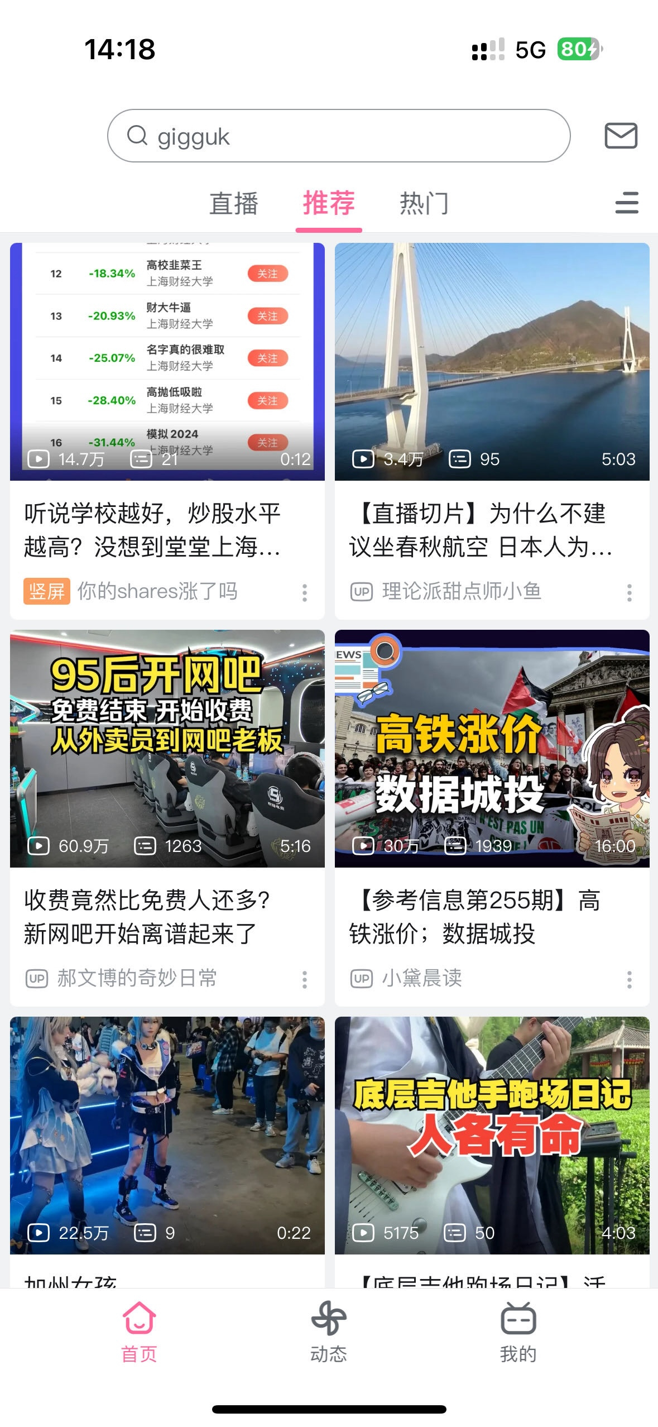
Teaser
Here are three examples of how recommender systems affect our Internet lives

Slide 3
Outline
A. Introduction to a Recommender System (RS)
B. How We Can Build a User-centric RS
C. RS + Multi-modal & RS + LLMs
D. POI Recommendation
E. Transformer & Chain of Thought (CoT)
REFERENCES

Slide 4
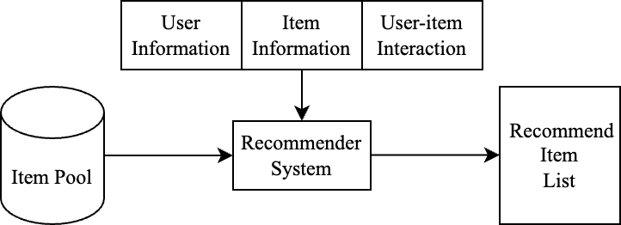
A. Introduction to a Recommender System (RS)
Here’s a figure depicting how a recommender system works. The key is to model users’ interests from limited interactions.

Slide 5
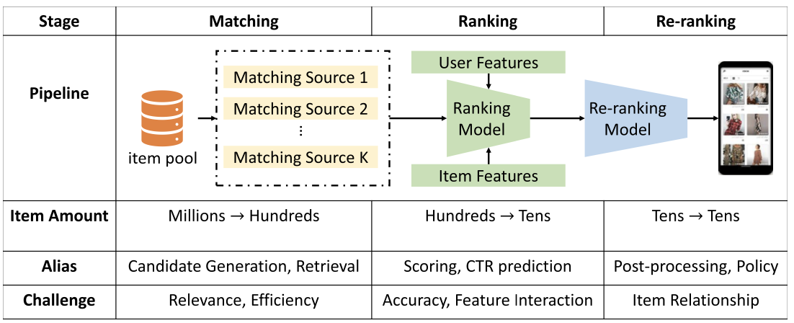
A. Introduction to a Recommender System (RS)
Due to the large amount of items in the item pool, the RS usually adopts a two- or three-stage matching & rank (& re-rank) strategy to filter out items.
In practice, most works put their primary attention on the Matching stage.

Slide 6
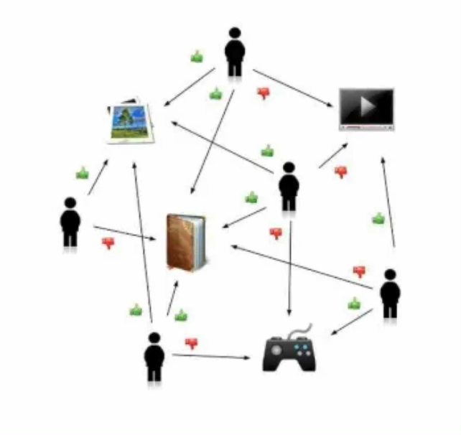
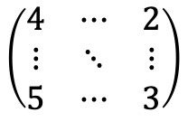
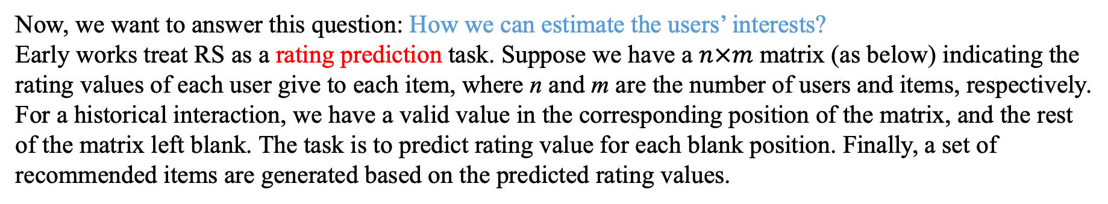
A. Introduction to a Recommender System (RS)
Now, we want to answer this question: How we can estimate the users’ interests?
Early works treat RS as a rating prediction task. Suppose we have a $n×m$ matrix (as below) indicating the rating values of each user give to each item, where n and m are the number of users and items, respectively.
For a historical interaction, we have a valid value in the corresponding position of the matrix, and the rest of the matrix left blank. The task is to predict rating value for each blank position. Finally, a set of recommended items are generated based on the predicted rating values.
$$\left(\begin{matrix}4 & ⋯ & 2 \\ ⋮ & ⋱ & ⋮ \\ 5 & ⋯ & 3\end{matrix}\right)$$
How we can fill in blanks in the matrix? Collaborative Filtering!
Keyword: similarity
Development:
User CF, Item CF → Matrix Factorization → LR / GBDT → wide & deep
→ NCF (SIGIR ‘16 best paper) → DIN → DIEN → DSIN …
Notes:
Heavy computational cost

Slide 7
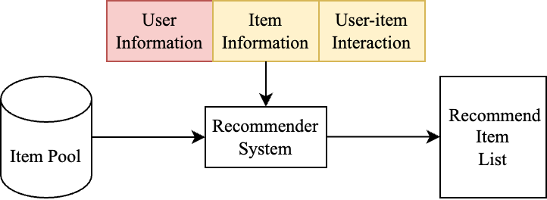
B. How We Can Build a User-centric RS
Recall the pipeline below:
Current works usually adopt a paradigm that fits users’ historical patterns to predict whether or not he / she would like target items.
Example:
Steve is a user on a movie-rating platform. He’s watched several movies, and the sequential IDs of the movies are: 0023, 0010, 1135, 6587, 4566, …, 2268, 2563, 3399
The training process is to fit the pattern of historical IDs with supervision signal. The sequence is cut into two parts, say, 0023, 0010, …, 2268 and 2563, 3399. The former are known to the model, and the latter serves as Ground Truth (GT). When serving, the historical IDs are also visible to the model.

Slide 8
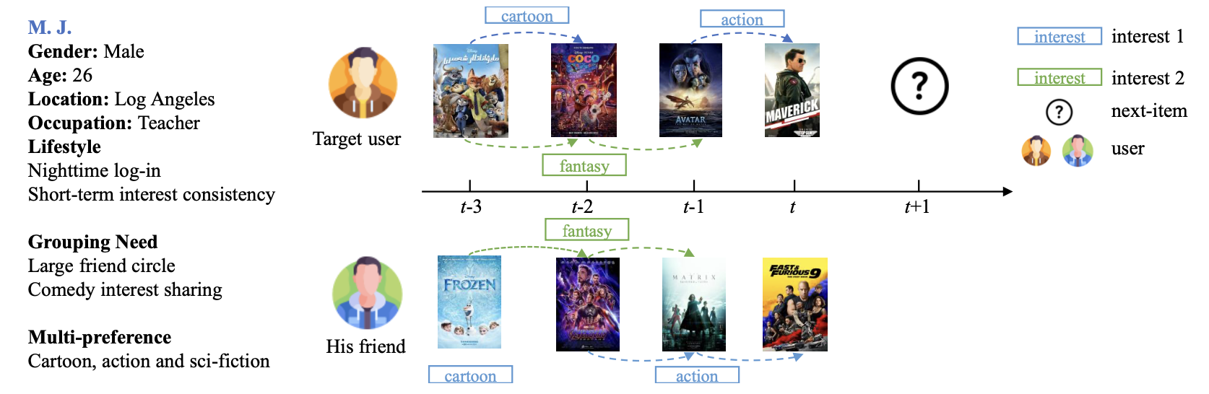
B. How We Can Build a User-centric RS
Despite progress in incorporation of side information of items and various graphs helping to mine user-item interactions, few works concentrate on user-side information. Let’s see the example below.

Slide 9
B. How We Can Build a User-centric RS
Overall of the proposed framework. The user profile on the upper side includes static attributes and watched history in sequence. The profile will be updated after each epoch and fed into the model input starting from epoch 2.
Jingyu Xu, Zhengwei Yang, Zheng Wang. Beyond Preferences: Enriching User Profiles for Effective E-commerce Recommendations. IEEE TCSS (under review).

Slide 10
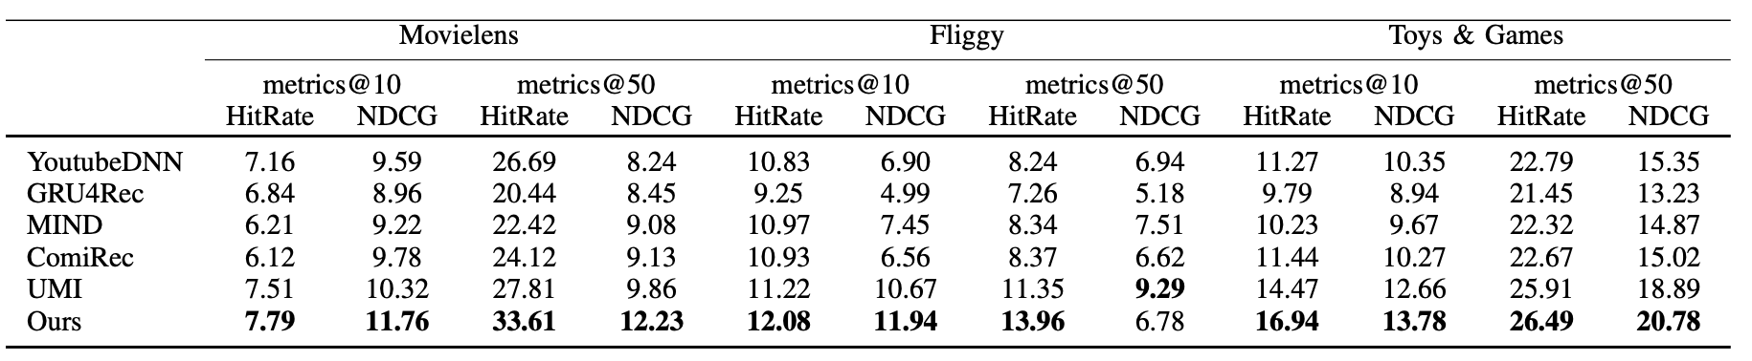
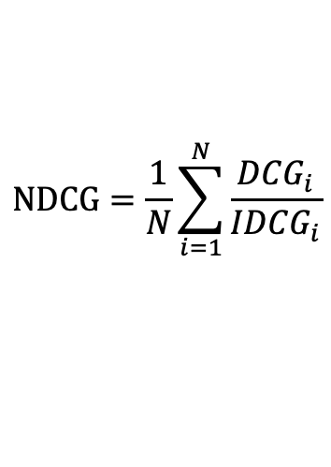
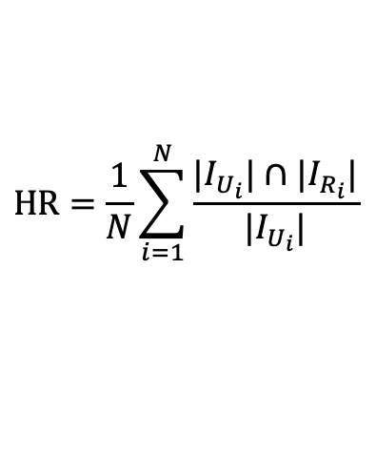
B. How We Can Build a User-centric RS
$$HR=\frac{1}{N}\sum_{i=1}^{N}{\frac{|I_{U_{i}}|∩|I_{R_{i}}|}{|I_{U_{i}}|}}$$
$$NDCG=\frac{1}{N}\sum_{i=1}^{N}{\frac{{DCG}_{i}}{{IDCG}_{i}}}$$

Slide 11
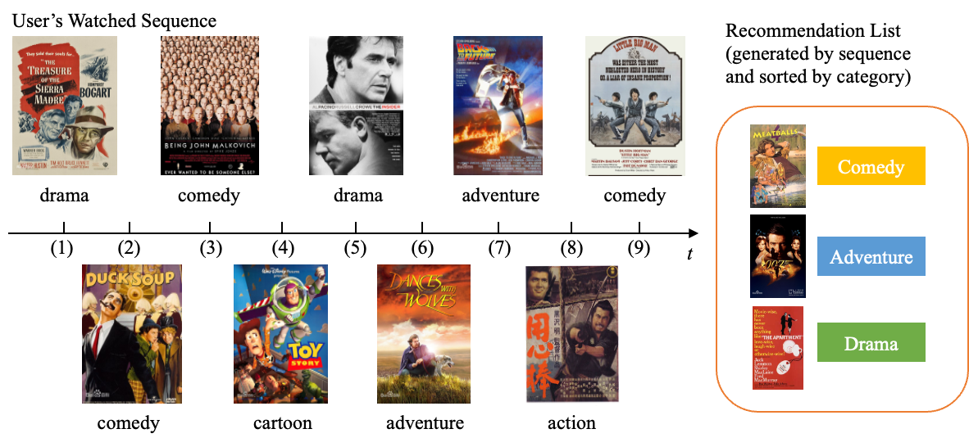
B. How We Can Build a User-centric RS
Visualized results:

Slide 12
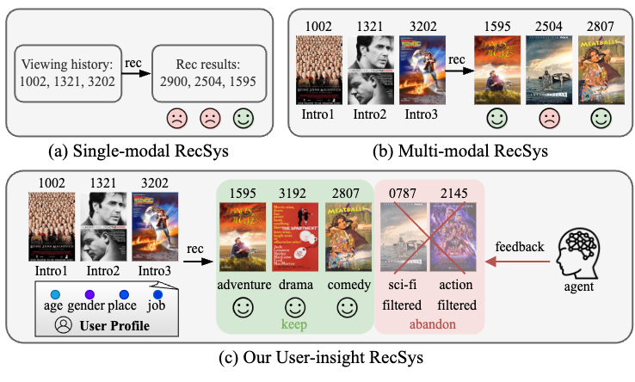
C. RS + Multi-modal & RS + LLMs
The pipelines of three kinds of recommender systems.
(a) single-modal recommender system, where usually only the ID embedding of historical items is fed into the system for recommendations generation;
(b) multi-modal recommender system, which additionally takes multi-modal information of items as input to enhance item representation;
(c) our user-insight multi-modal recommender systems, where the user profile is integrated with historical records to collectively extract the user's interests, and the system gives recommendation results after obtaining feedback from a simulated user agent with initial categorized results.
Jingyu Xu, Zechao Hu, Caoyuan Ma, Zhengwei Yang, Hao Li, Zheng Wang. User Plays a Role: User-insight Multi-modal Recommendation. ACM MM ‘24 (under review)

Slide 13
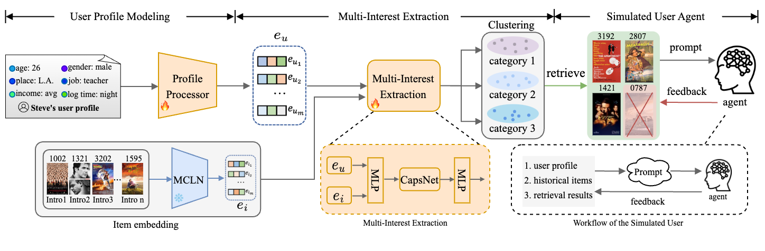
C. RS + Multi-modal & RS + LLMs
Overview of our proposed framework. Different from previous works that only use historical records, the framework takes into both pre-enhanced user profiles and users' historical records as input. The records are embedded, purified, and fused with the backbone model; and after the user profiles are embedded, a multi-interest extraction module is utilized with dual two-layer MLPs and a CapsNet to project the user profile information into the historical records and cluster the users' interests. Finally, after initial recommendation results are generated, we use a simulated user agent to refine the recommendations to get a more precise outcome. Details of the multi-interest extraction and the simulated user are shown at the bottom of the figure.

Slide 14
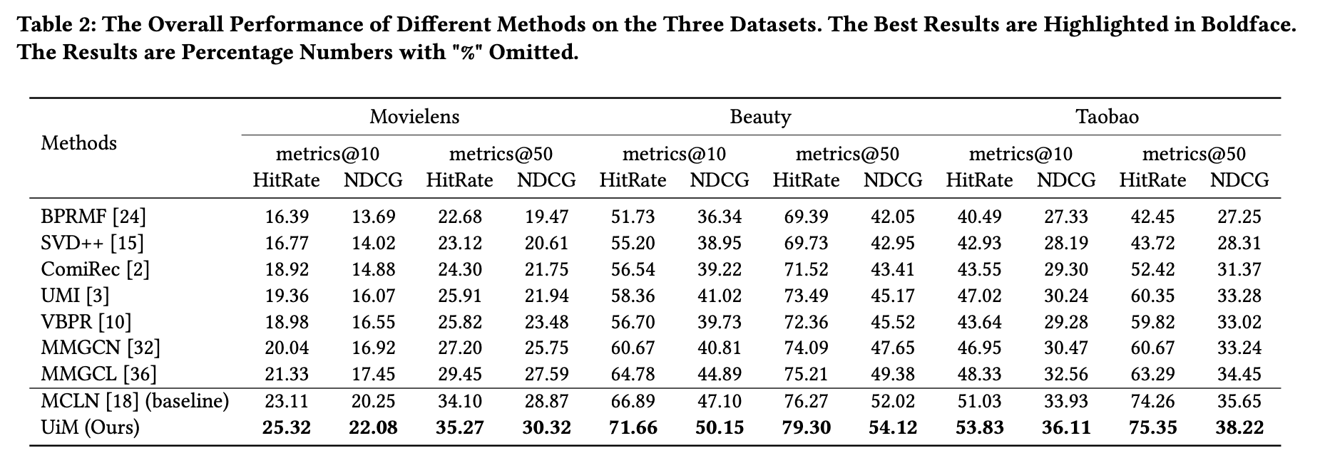
C. RS + Multi-modal & RS + LLMs

Slide 15
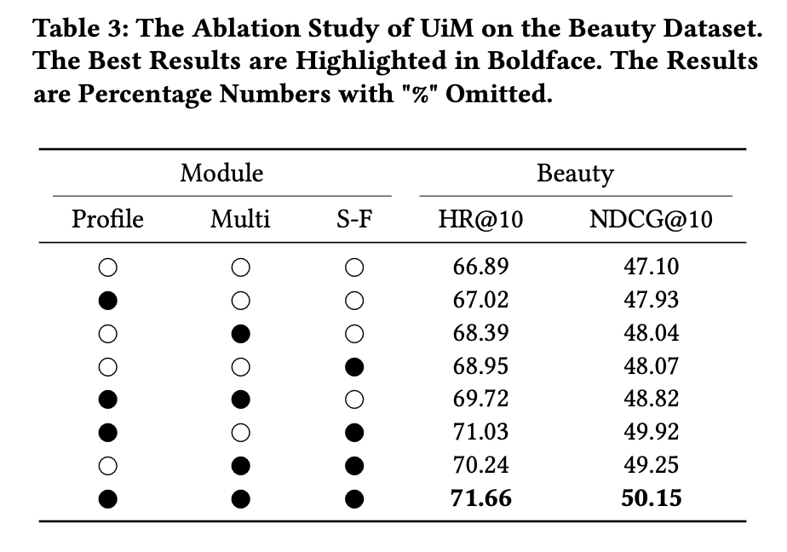
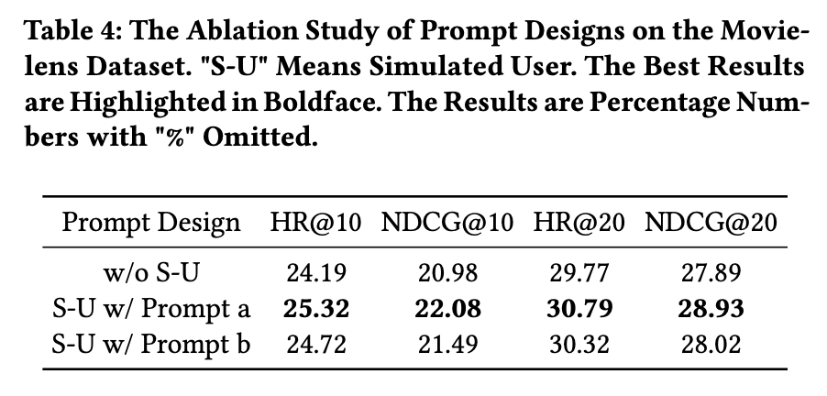
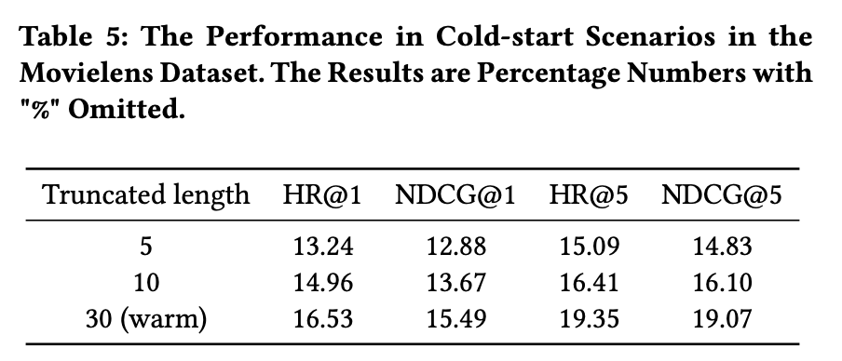
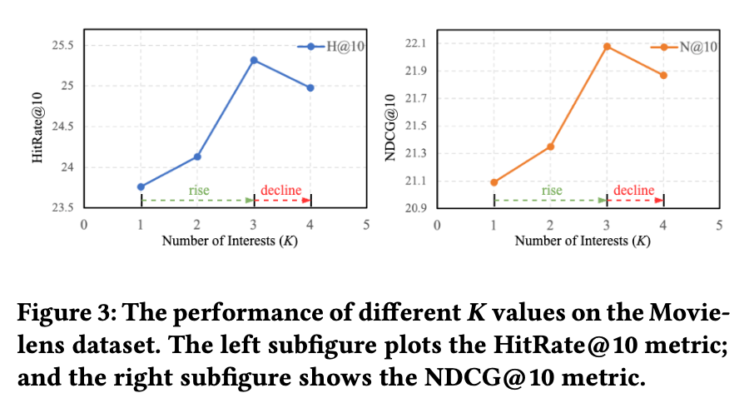
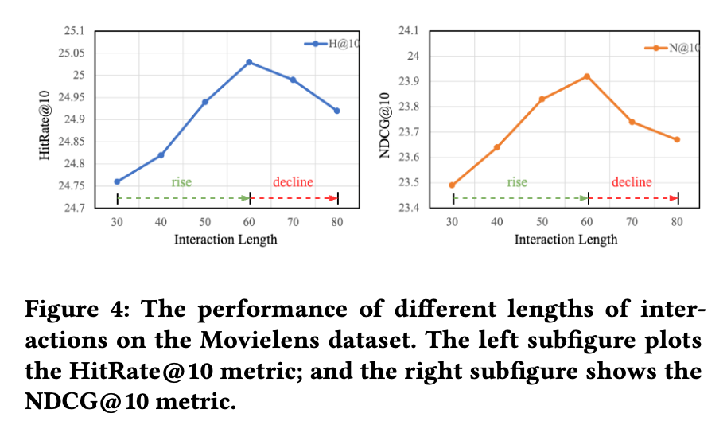
C. RS + Multi-modal & RS + LLMs

Slide 16
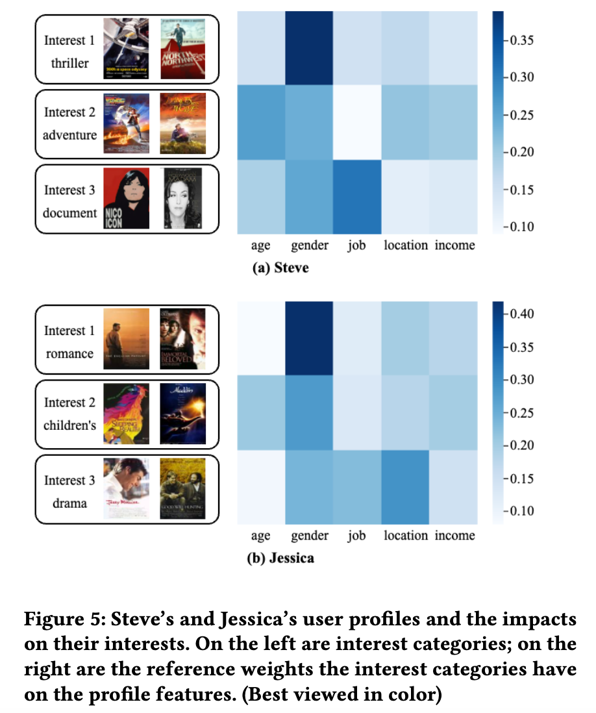
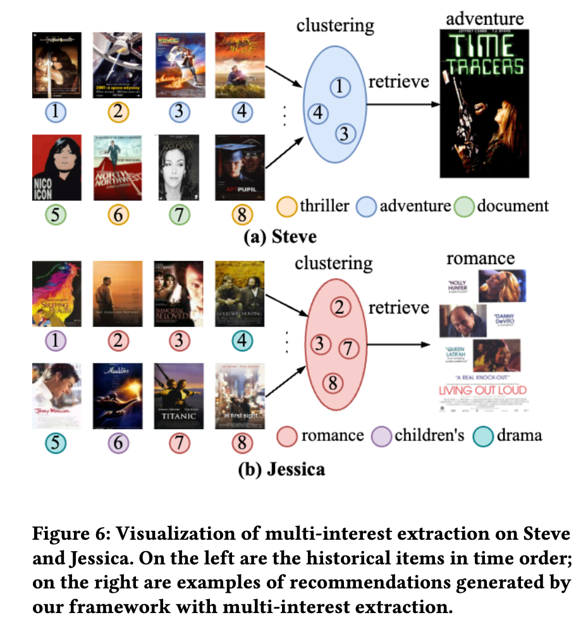
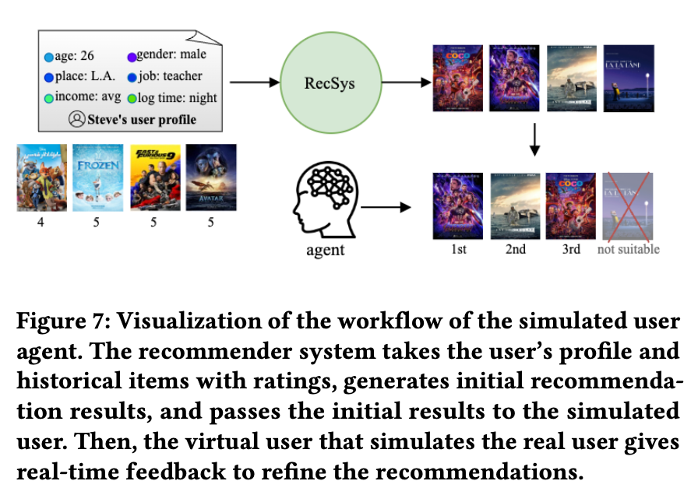
C. RS + Multi-modal & RS + LLMs

Slide 17
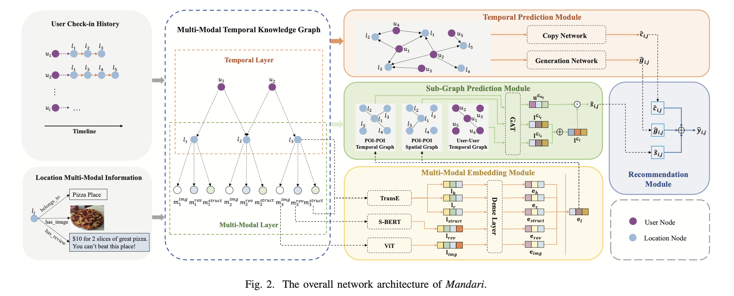
D. POI Recommendation
A Next-POI Recommender System serves in location-based services like map services (Google Maps, Baidu Maps, AMap), takeout delivery services (Meituan, Dianping), etc.
Compared to product recommendation, a POI recommendation algorithm focuses on the modeling of geographical information of places, and the contextual information of users’ check-ins. Here’s an example:

Slide 18
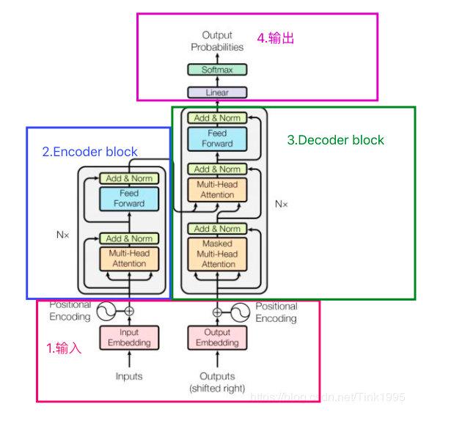
E. Transformer & Chain of Thought (CoT)
Transformer was proposed by Google, and has been applied to many domains.

Slide 19
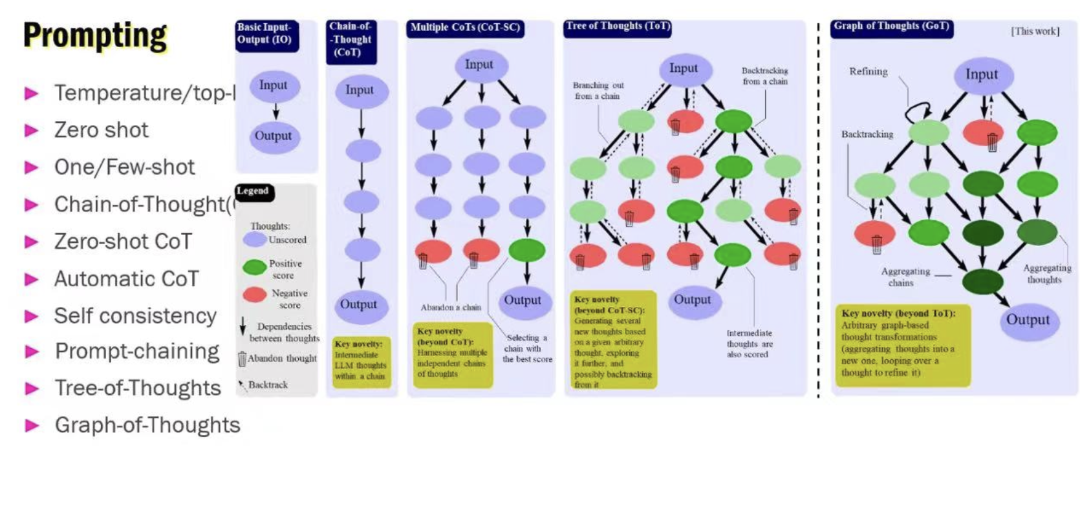
E. Transformer & Chain of Thought (CoT)
CoT is a technique widely used in Large Language Models (LLMs). In such models, CoT can help them better understand and handle complex tasks, such as reasoning and explanation.
Specifically, CoT guides the model to go through a series of intermediate steps before generating an answer, thereby enabling the model to produce more reasonable and accurate responses. When dealing with questions that require reasoning or explanation, the model first generates a series of intermediate steps, which form a “Chain of Thought,” and then generates the final answer based on these intermediate steps.

Slide 20
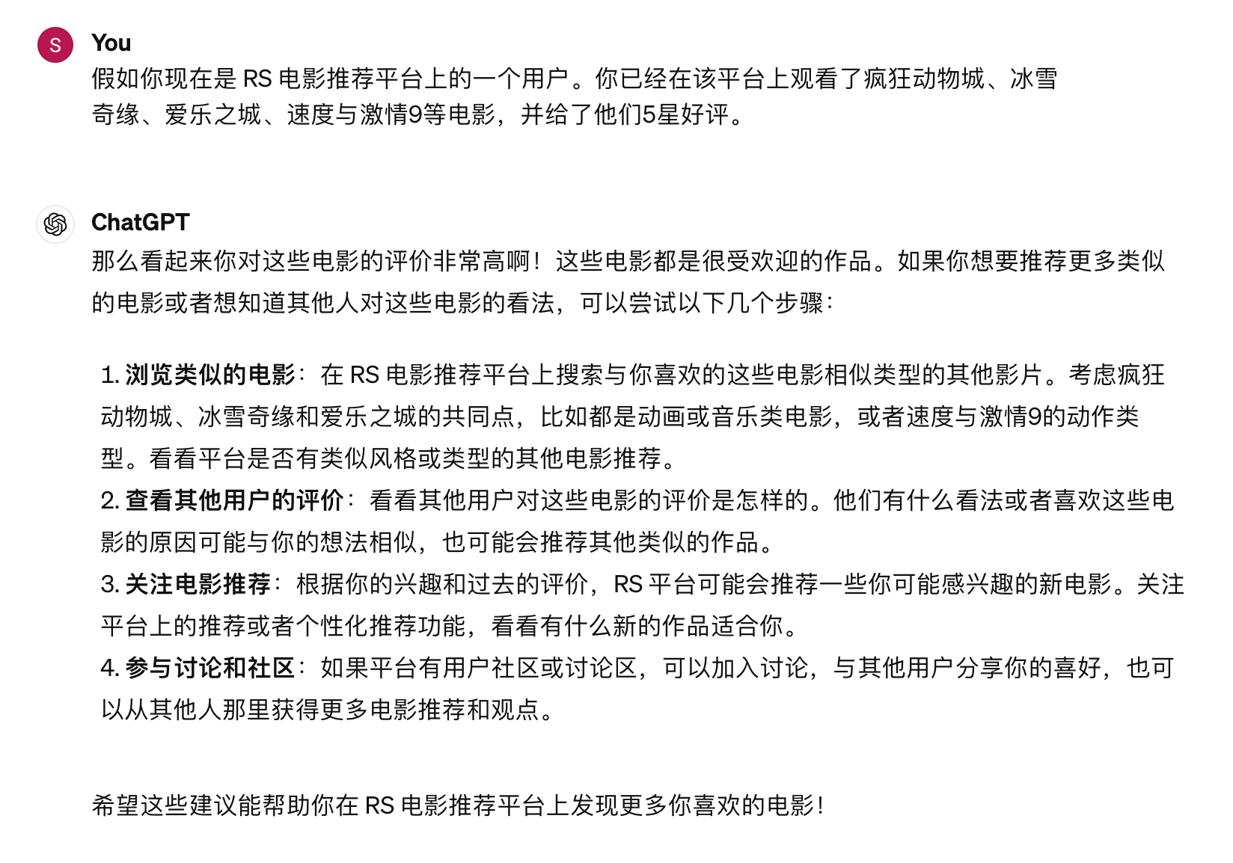
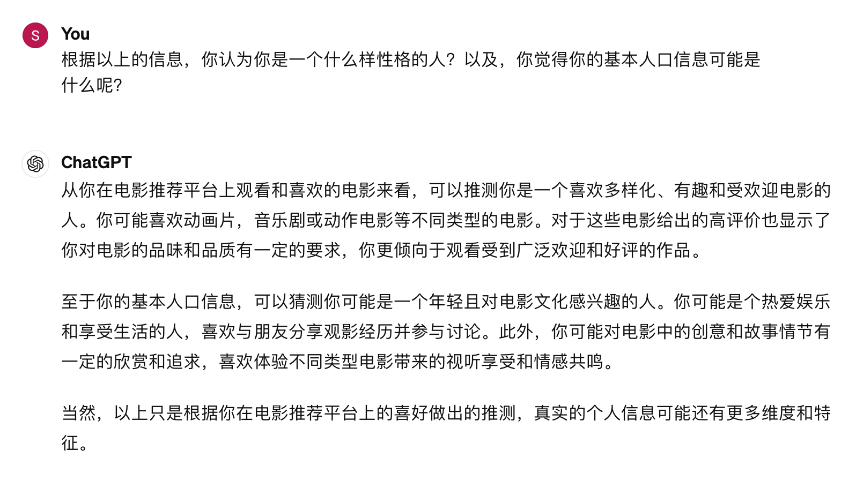
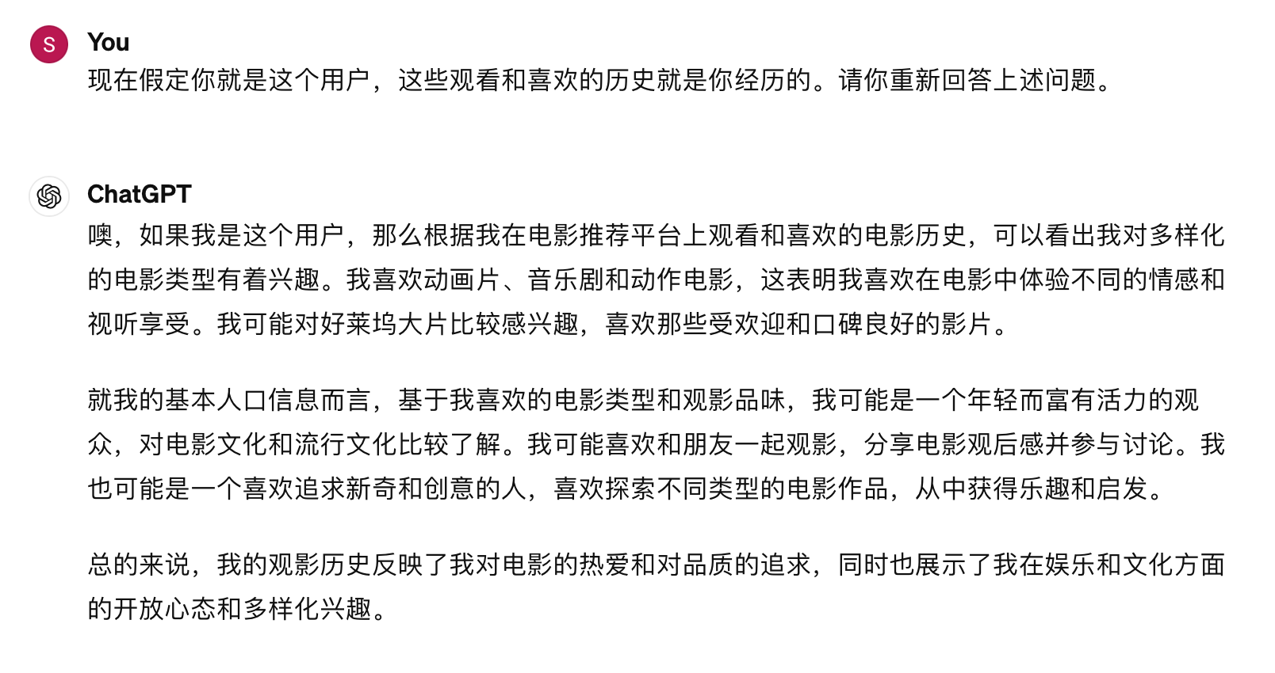
E. Transformer & Chain of Thought (CoT)

Slide 21
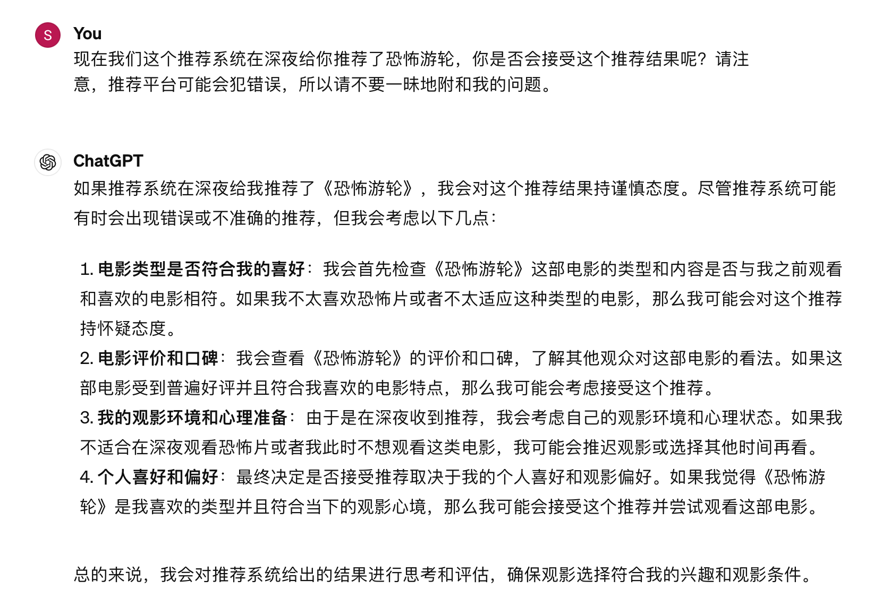

E. Transformer & Chain of Thought (CoT)
However, in the prompt process above, the LLM just memorizes the instructions, but didn’t update its parameters.
If you want to fine-tune a general LLM to adapt to downstream tasks, you can partially fine-tune it with instruction tuning, which allows the LLM to learn new knowledge in a supervised manner.

Slide 22
E. Transformer & Chain of Thought (CoT)
Here’s an example:
The instruction format typically includes a task description, a pair of input and output, and examples (optional).
For example, “Please answer the following question: What is the capital city of China?”, Response: “The capital city of China is Beijing”, where “Please answer the following question:” is the task description, “What is the capital city of China?” is the input, and “The capital city of China is Beijing” is the output.
Another example: “Please translate the following English to Chinese, input example: The capital city of China is Beijing, output example: 中国的首都是北京.
Instruction Tuning can help LLMs have better reasoning abilities, thus demonstrating excellent generalization to unseen tasks. That is to say, even if the instructions for fine-tuning do not design related tasks, the performance of the large model on new tasks will be better than before fine-tuning.

Slide 23
REFERENCES
[1] Gao C, Zheng Y, Li N, et al. A survey of graph neural networks for recommender systems: Challenges, methods, and directions[J]. ACM Transactions on Recommender Systems, 2023, 1(1): 1-51.
[2] Chai Z, Chen Z, Li C, et al. User-aware multi-interest learning for candidate matching in recommenders[C]//Proceedings of the 45th International ACM SIGIR Conference on Research and Development in Information Retrieval. 2022: 1326-1335.
[3] Tian Y, Chang J, Niu Y, et al. When multi-level meets multi-interest: A multi-grained neural model for sequential recommendation[C]//Proceedings of the 45th International ACM SIGIR Conference on Research and Development in Information Retrieval. 2022: 1632-1641.
[4] Tao W, Li Y, Li L, et al. SMINet: State-Aware Multi-Aspect Interests Representation Network for Cold-Start Users Recommendation[C]//Proceedings of the AAAI conference on artificial intelligence. 2022, 36(8): 8476-8484.

